Slide 1

Implementing the Clinical Quality Framework: Demonstrating that CQF Standards Work and Driving Standards Improvement
August 18, 2016
Julia Skapik, MD, MPH
Medical Officer
Office of the National Coordinator for Health IT IT

Slide 2
The Clinical Quality Framework
Goals
To harmonize standards for CDS and eCQM
To harmonize with relevant standards (e.g., CIMI, FHIR) to facilitate widespread adoption
To refine and validate the standards via pilot implementations
Expected Benefits
Reduced implementer burden
Increased re-use of eCQM artifacts in CDS and vice versa
Improved standards quality through unification of community effort

Slide 3
CQF: A Pilot-Based Approach
CQF’s pilot program grew out of a Standards & Interoperability Framework Initiative
The goal was to demonstrate that CQF standards addressed the clinical functionalities, expressions, and usability intended
Pilots lead to ongoing improvements to the standards and feed back into the pilots themselves]
Goal was also to bring in greater implementer perspective to standards development

Slide 4
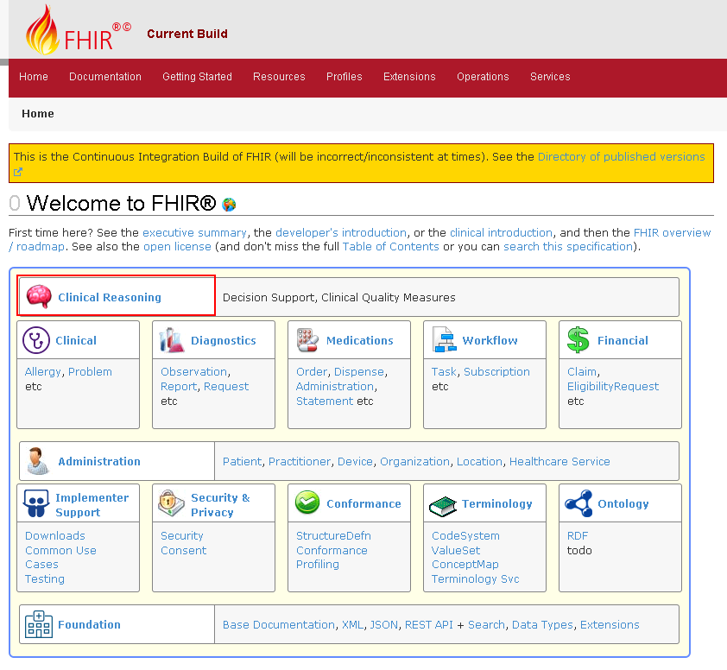
CQF FHIR IG
IG supports
CDS knowledge artifacts (rules, order sets, documentation templates)
Quality measures
Service-based evaluation
http://hl7-fhir.github.io/clinicalreasoning-module.html

Slide 5
CQF Pilots
Pilots | Point of Contact | Liaison SME
Breast Cancer Decision Support | Chad Armstrong | Claude Nanjo
Cardiology Appropriateness of Use | Rachel Davis | Chris Moesel
Chlamydia Screening | Johanna Goderre-Jones | Bryn Rhodes
Immunization Decision Support Services (Immunization DSS) | Daryl Chertcoff | Claude Nanjo
Ischemic Vascular Disease: Use of Aspirin or Other Antithrombotic (Portable CDS Knowledge Artifacts) | Julie Scherer | Claude Nanjo
Phenotype Execution and Modeling Architecture | Will Thompson | Bryn Rhodes/ Chris Moesel
Radiology Appropriateness of Use | Tom Conti | Bryn Rhodes
Others in Planning (e.g., Opioid Management) | TBD | TBD
CQF Wiki: cqframework.info 4

Slide 6
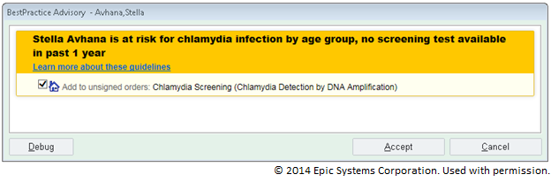






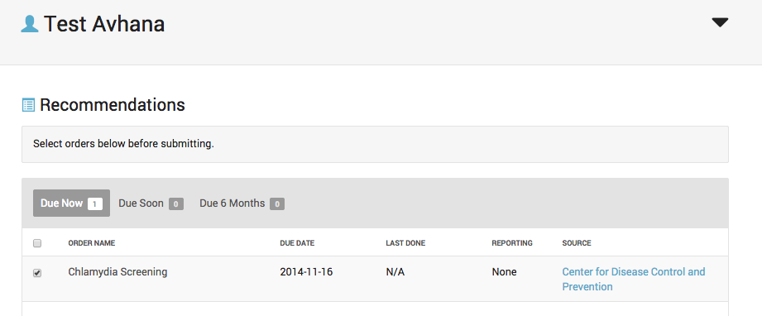
CQF Pilots Chlamydia Screening
Chlamydia Screening Rule
in
KAS + CQL + QUICK
CQF Wiki: cqframework.info 18
Notes:
Primary objectives: validate use of FHIR as messaging model using “man in the middle” approach; advance the HL7 Conformance Testing Program by automating and executing test cases
A FHIR Profile will be developed which is aligned with QUICK.
Develop the man-in-the middle transformation software. FHIR messages are transformed to vMR and submitted to the ICE service; response from ICE is relayed back to the client.
Modify the HTML5 client (previous page) to accept a FHIR immunization forecasting request conforming to the FHIR profile defined during this project, and receive FHIR responses from the service.
Modify the immunization forecasting tester used by Texas Children’s Hospital (TCH) to submit test cases based on FHIR
Utilize AEGIS Developers Integration Lab software to advance the HL7 Conformance Testing Program by automating and executing test cases for immunization forecasting. (See http://www.hl7.org/implement/conformanceTesting.cfm)
2) Secondary objectives(resources permitting):
- update underlying data model for knowledge authoring and knowledge execution to use QUICK (vs. vMR) and potentially CQL

Slide 7
Immunization DSS Pilot
Leveraging existing software to validate CQF standards for Immunization Forecasting
The goal of the Immunization DSS Pilot is to validate how CQF standards can support and evolve immunization forecasting.
Pilot accomplishments to date:
Utilized latest FHIR standards
Implemented a “man in the middle” approach whereby FHIR requests can invoke several (existing) immunization forecasting products, demonstrating the viability of incorporating existing products with latest standards
Demonstrated capability at two HL7 FHIR Connectathons
May demonstrate at the next HL7 Connectathon to demonstrate using the latest FHIR-Based Clinical Decision Support IG
Shared lessons learned with the CQF team during the development of FHIR-based CDS standards
CQF Wiki: cqframework.info 19

Slide 8
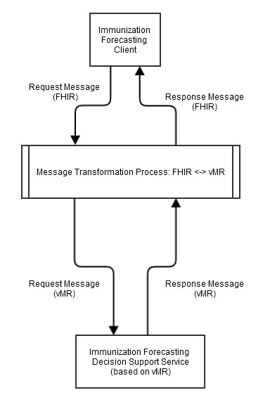
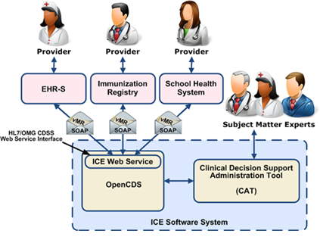
Immunization DSS Pilot
Example Use of FHIR as a Data Exchange Model
CQF Wiki: cqframework.info 20
Notes:
Primary objectives: validate use of FHIR as messaging model using “man in the middle” approach; advance the HL7 Conformance Testing Program by automating and executing test cases
A FHIR Profile will be developed which is aligned with QUICK.
Develop the man-in-the middle transformation software. FHIR messages are transformed to vMR and submitted to the ICE service; response from ICE is relayed back to the client.
Modify the HTML5 client (previous page) to accept a FHIR immunization forecasting request conforming to the FHIR profile defined during this project, and receive FHIR responses from the service.
Modify the immunization forecasting tester used by Texas Children’s Hospital (TCH) to submit test cases based on FHIR
Utilize AEGIS Developers Integration Lab software to advance the HL7 Conformance Testing Program by automating and executing test cases for immunization forecasting. (See http://www.hl7.org/implement/conformanceTesting.cfm)
2) Secondary objectives(resources permitting):
- update underlying data model for knowledge authoring and knowledge execution to use QUICK (vs. vMR) and potentially CQL

Slide 9
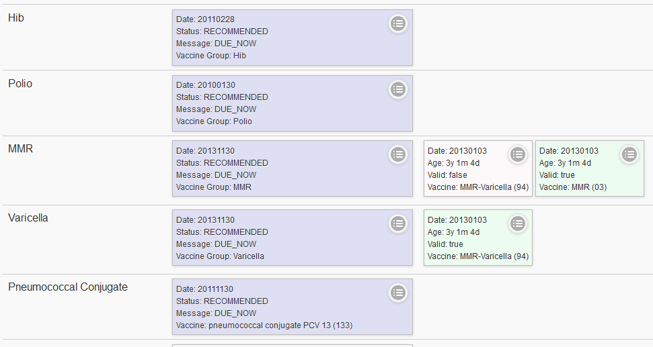
Immunization DSS Pilot
ICE Sample User Interface is currently based on vMR
CQF Wiki: cqframework.info 21
Notes:
This screen is a sample HTML5 front end UI to the Immunization Calculation Engine (ICE) – available as an app for Android, iPhone, iPad; and on the web. This sample front end is live and can be tried out on the web at https://cds.hln.com/iceweb/#about
The UI can currently parse vMR. Patient can be imported into the front end by uploading a file in vMR format and subsequently submitted to the ICE service. (OR, the user can type in the immunization history manually and run the service.)
This HTML5 client will be modified for purposes to support FHIR for this pilot. (See notes on next screen.)

Slide 10






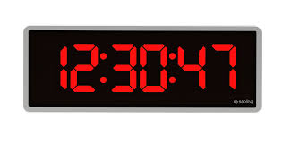

Pilot Survey Results: Cycle 2/3
MORE EXPERTS
MORE TIME
resources that could have made pilots more successful
100%
percentage of pilots that met their goal(s)
8+
artifacts and tools created as part of the pilots
2700+
hours spent by pilot teams in 4 months of pilot work
ALL
pilots felt they received the support they needed
8.7
average rating for overall CQF pilot experience
The project team has provided us with valuable guidance on the current state of the CQF standards, and how they will evolve moving forward. This is the kind of support we were looking for in joining as a pilot project.
…having one-on-one sessions with our pilot advisor Bryn really helped solidify/ speed up our pilot design and progress…
We see great opportunity and need for continued development of the standards…
Information is based on 4 survey responses received to date
CQF Wiki: cqframework.info 16

Slide 11
Current Cycle Pilots
Pilot | Focus
IOM DIGITizE | Expressing pharmacogenomics data to demonstrate ability to code personalized medicine into systems and decision support at the point of care
Transcend Insights/ Humana | Reexpressing and computing HEDIS measures for quality performance
Plexina | Expressing clinical order sets at the point of care using standards
Blue Cross Blue Shield | Reexpressing quality metrics using claims data
IBM | Computability of clinical data and analytics

Slide 12
Recent Connectathons
Breastfeeding for Newborns
IHE Radiology Guidance Request Scenario
CDC Immunization Guidance Scenario
CQF-SOA Integration
Payer Extract

Slide 13
PenRAD DEmo
Demonstrating CQF Works:

Slide 14
Conclusions
Perhaps all standards development should be accompanied by ongoing testing and implementation
Engaging implementers early leads to fewer revisions and improved results
Usability and feasibility may be best assessed through implementation and connectathons
The community wants to engage with us and advance the field so we can all benefit from better standards– just invite them in!

Slide 15
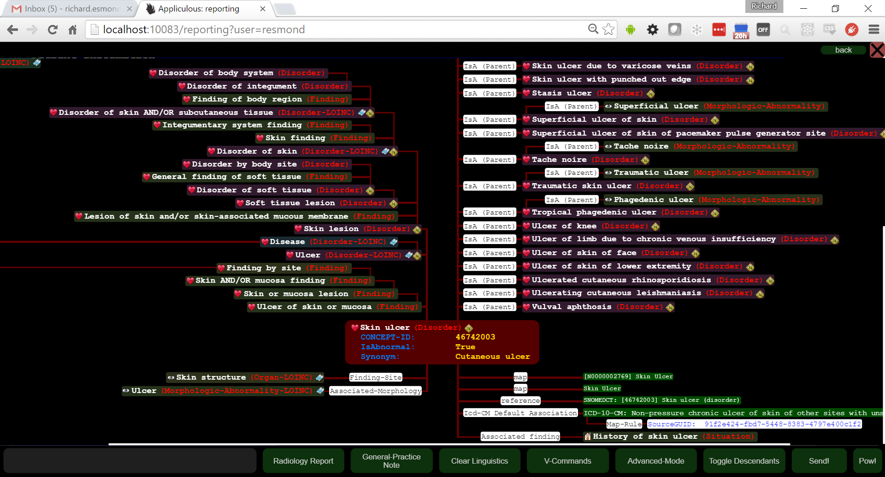
Conclusions

Slide 16
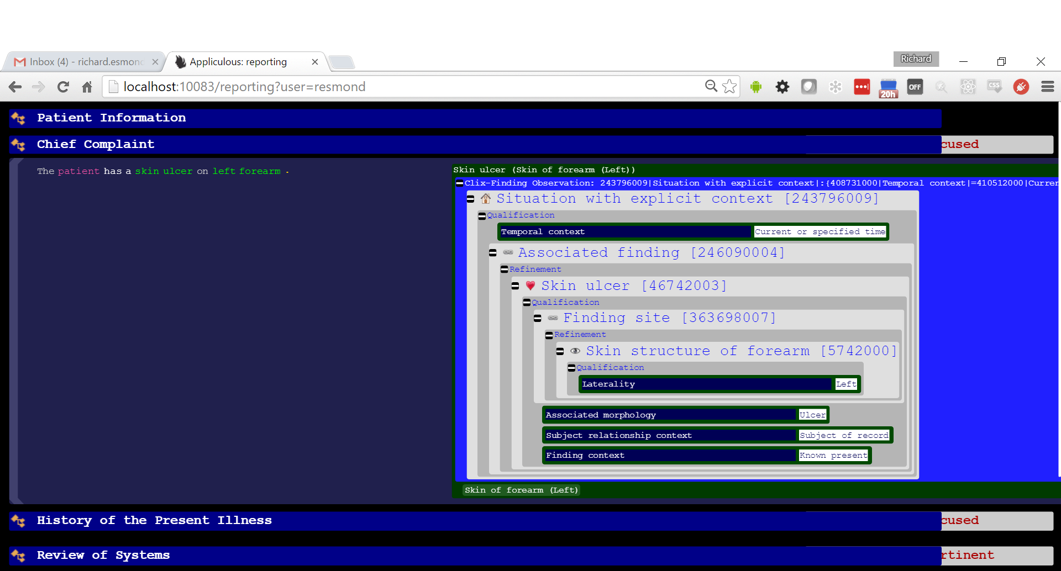
Conclusions

